Slide 1


Social Pulse
Understanding Brand Perception using Social Media Analytics
Team:
Murali Dandu
Christopher Light
Hao Qiu
Liyang Ru
Pai Tong
Yen-Ju Tseng

Slide 2
Agenda:
Motivation
User Story
Data
Models and Analytics
Architecture
Dashboard Demo

Slide 3
Motivation
Background
Solution
80% brand marketers agree that social listening has increased value
Need for Performance measurement, brand reputation, product development, competitive insights etc
Currently, lot of standalone analytics with no consolidated tool
Proposed Solution:
Unified brand perception tool analyzing different social streams
Need to understand sentiment, emotion and key topics across different dimensions
Social Pulse

Slide 4





User Story – Brand Manager
35
Sr. Marketing Manager
Mobile Making Company
Frustrations
Low response manual surveys
Time consuming product decision making
Not able to understand online brand perception
Friction between product and marketing teams
Brand Manager, Marketing Manager
Wants and Needs
Marketing is my passion and I love increasing my product’s brand value. I want to understand customer’s perception to understand pain points and help device product and marketing strategies
Want to understand customer sentiment and emotion
Want to listen to social media for brand perception
Want to make faster decisions using multi-faceted analytics
Need to create a competitive edge

Slide 5


Data
Twitter
Tweepy
Has geospatial data, but less context, and more marketing info
Reddit
PRAW
More comment content, better diversity of searches
API
Pros/Cons
From each stream, per brand: 1k comments → 2k/brand
Info Collected: Text, upvotes, time of creation, location, ids.

Slide 6
Detection Models
Sentiment Detection
Emotion Detection
Positive, Neutral, Negative
Output
Joy, Sadness, Surprise, Anger, Fear
Twitter and Reddit Sentimental Analysis Dataset
Dataset
Emotion Dataset
TF-IDF Transformation
Features
TF-IDF Transformation
Scikit-Learn LinearSVC
Model
Scikit-Learn LinearSVC

Slide 7
Keyword Extraction Methods
YAKE
KeyBERT
Aggregate data for a brand and stream
Aggregate data for a brand and stream
YAKE Unsupervised KW Extraction
KeyBERT KW Extraction
Sub-Topic Analysis
Co-occurrence Keyphrase Graph

Slide 8
















Architecture - Authenticating with Docker Hub for AWS
Region
Availability Zone
Users
Visual Private Cloud
Public subnet
Amazon Elastic Container Service (Amazon ECS)
AWS Key Management Service (AWS KMS)
AWS Identity and Access Management (IAM)
SSH Connect
Internet
gateway
Elastic network interface
AWS Fargate
Permissions
AWS Role
Task
AWS Secrets Manager

Slide 9
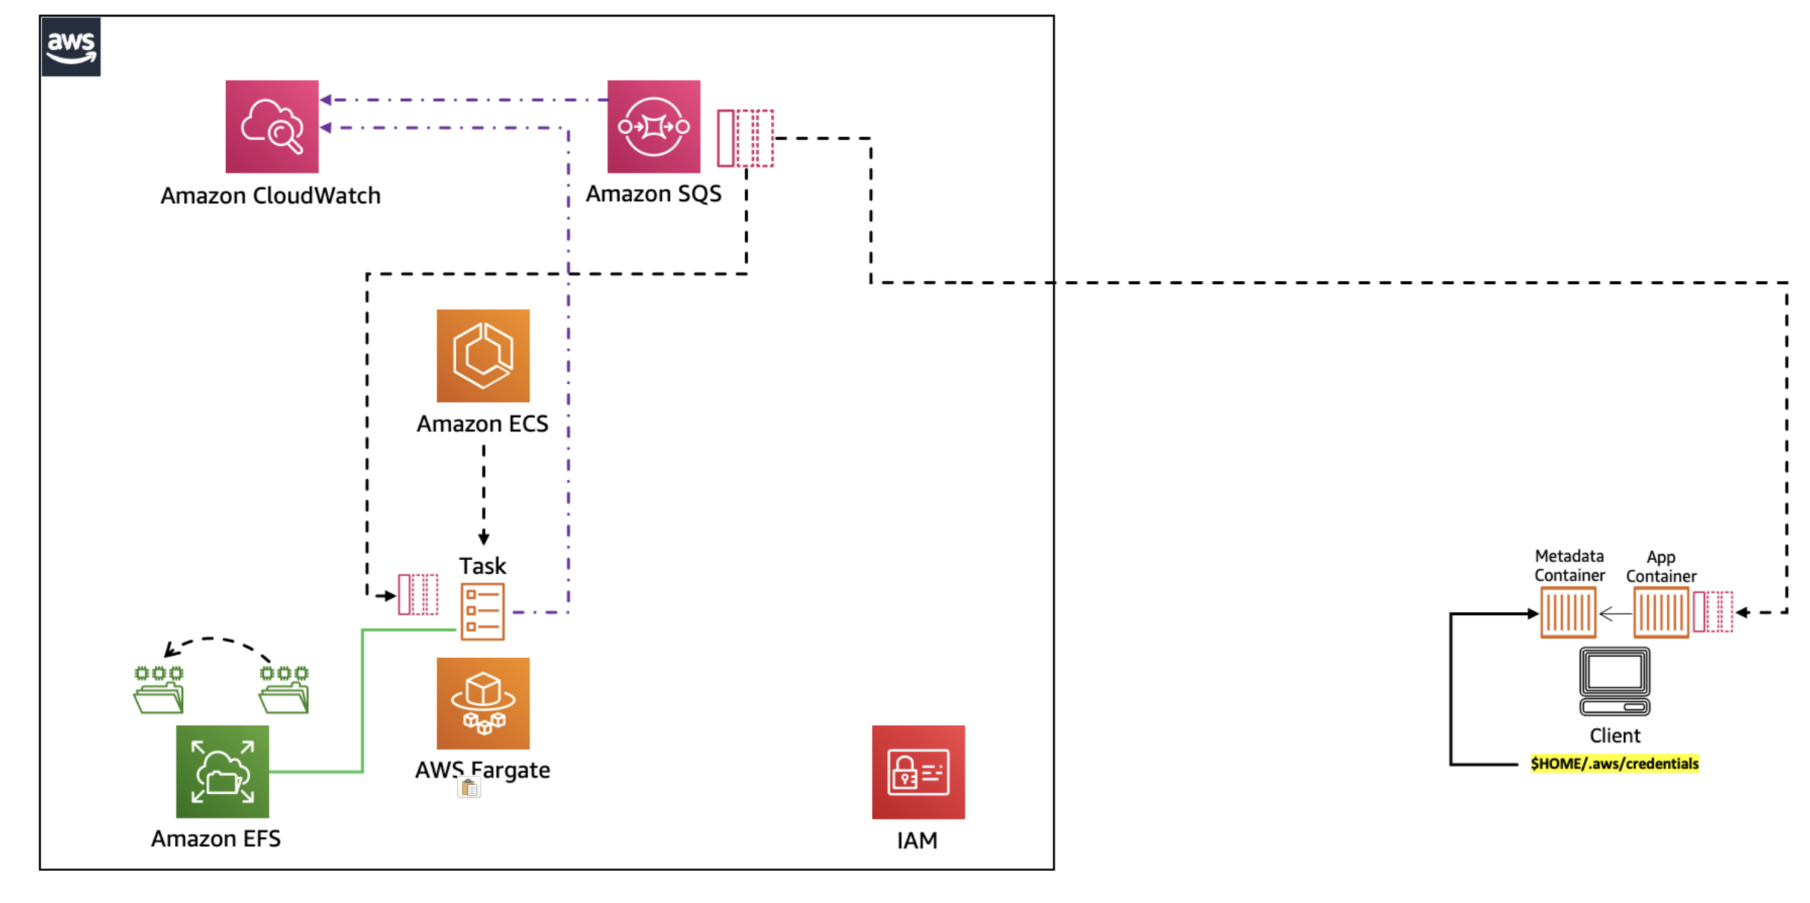

Architecture - Deployment on Amazon ECS using Docker Compose

Slide 10
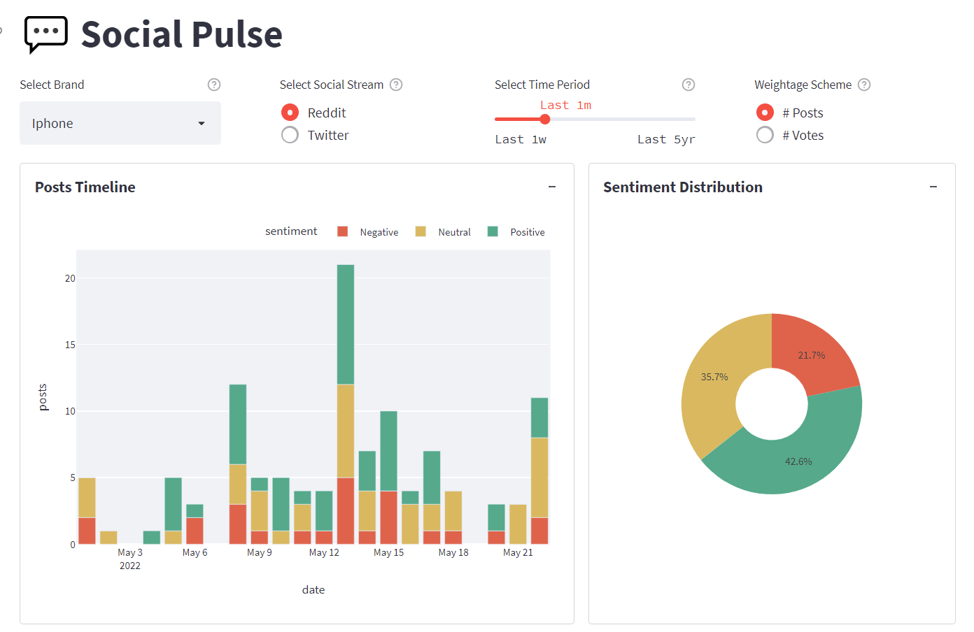
Demo
http://18.234.216.224:8501/

